Slide 2

Shanawaz Sheriff
Practice Head – Data & AI , Acuvate

Slide 3

Implementing Data Mesh on Azure
Thursday, 20th October 2022

Slide 4

Problem with existing Architectures
There’s a deep assumption that centralization is the solution to data management. This includes centralising all data and management activities using one central team, building one data platform, using one ETL framework, using one canonical model etc.,
Analytical Consumers
Transactional Sources
Curate
Clean
Analyse
Centralised Architecture
Translate
Model
Single team with centralised knowledge and book of work
Centralised pipelines for all extraction / ingestion activities
Centralised transformations applied for harmonized data
Central platform serves as a large integration database: all execution and analysis is done on the same platform
Analytical Consumers
Transactional Sources
Magic Box
Transform
Conform
Analytical Consumers
Transactional Sources
Model
Enrich
Predict
Hogward’s School of Witches and Wizardry
Data Consumers
Data Providers

Slide 5
Problem with existing Architectures
There’s a deep assumption that centralization is the solution to data management. This includes centralising all data and management activities using one central team, building one data platform, using one ETL framework, using one canonical model etc.,
Analytical Consumers
Transactional Sources
Curate
Clean
Analyse
Centralised Architecture
Translate
Model
Single team with centralised knowledge and book of work
Centralised pipelines for all extraction / ingestion activities
Centralised transformations applied for harmonized data
Central platform serves as a large integration database: all execution and analysis is done on the same platform
Analytical Consumers
Transactional Sources
Transform
Conform
Analytical Consumers
Transactional Sources
Model
Enrich
Predict
Centralised Engineering Team
Data Consumers
Data Providers

Slide 6
Business drivers for moving to Data Mesh
Many enterprises are saddled with outdated Data Architectures that do not scale to the needs of large multi-disciplinary organisations.
Lack of Data Ownership
Lack of Data Quality
Difficult to see Interdependencies
Model conflicts across business outcomes
Tremendous effort of integration and coordination leads to bypasses
Siloed Teams => Business and IT work in silos
Disconnect between data producers and data consumers
Central team becomes the bottle neck
Difficult to apply policy and governance
Hard to see dependencies(Technical Debt)
Small changes become too risky due to unexpected consequences
Technical ownership, rather than data ownership

Slide 7
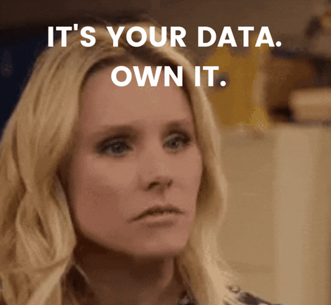
Data Mesh : Paradigm shift towards domain-ownership
New type of data eco-system, which shifts left towards a modern distributed data architecture that enables each domain to handle its own data pipelines allowing domain specific data and views as “Data as a Product”
Source-Oriented Domains
Data Product
Consumer Specific Transformation
Data Consumer
Consumption-Oriented Domains
Data Providers
Data Providers
Data Product
Consumer Specific Transformation
Data Consumer
Data Providers
Data Product
Consumer Specific Transformation
Data Consumer
Supporting governance and domain-agnostic platform infrastructure

Slide 8
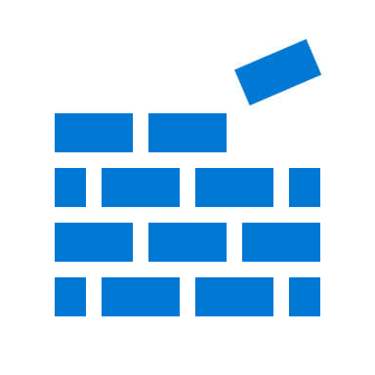
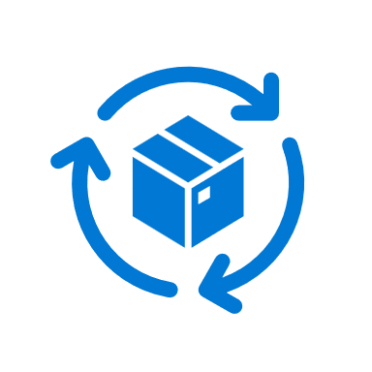


Data Mesh four foundation principles
Self serve data infrastructure as a platform
Federated Computational Governance
Domain-oriented decentralised data ownerships
Data as a Product
Architecture decomposed around domains : Origin and Knowledge of data.
Data domains are boundaries that represent knowledge, behaviour, laws and activities around data.
They are typically aligned with business concerns.
Treat data as a product : Stable, Read optimised, and ready for consumption.
Data from domain which has data transformation applied for improved readability and end user experience.
Delivering self serve data platform that abstracts the technical complexity.
Centred around automation, Self-service onboarding, global interoperability standards, and so on.
Building an ecosystem and culture that conforms to the same set of standards such as data quality, security etc.,
Requires topologies, discoverable metadata repositories, data marketplace, and data democratization capabilities.

Slide 9
Functional domain decomposition of a CPG Company
Customer Services Management
Voice of Customer
Marketing Partnership
Customer management
Discount and loyalty management
Promotion management
Campaign management
HR Management
Recruitment
Training and skill development
Employee engagement
Performance management
Turn over management
Employee productivity
IT Management
Infrastructure Procurement
Infrastructure provisioning
Issue Management
Incident management
Security
Operations
Supply chain Management
Demand Planning
Production Management
Logistics Management
Supply Tower
Order to Cash
Vendor Management

Slide 10





Modern Analytics and Governance at Scale
Azure approach to Data Mesh
Build data products leveraging different analytic patterns
Dashboards and Reports
Machine Learning
Operational data store
IOT Analytics
Digital Twins
Modern Apps
Customer Service Management
HR Management
Data Governance
Automated Services
Data Store
Data Catalogue
Data Classification
Data Lineage
Data Owner
Data use governance
Data policy
Data Sharing
Data Quality
Master Data
Operations Console
Automation
Domain zone provisioning
Data Products onboarding
Access provisioning
Data agnostic ingestion
Data standardisation
Meta Data Registration
Data Lake
Document database
Analytics Data Stores
4 Principles
Domain-oriented decentralised data ownerships
Data as a Product
Supply Chain Management
IT Management
Domain
N + 1
Self serve data infrastructure as a platform
Federated Computational Governance

Slide 11
What does a data product look like ?
Compute
Compute
Data Collection
Storage
Data
Insights
Data
Sources
Orchestration

Slide 12
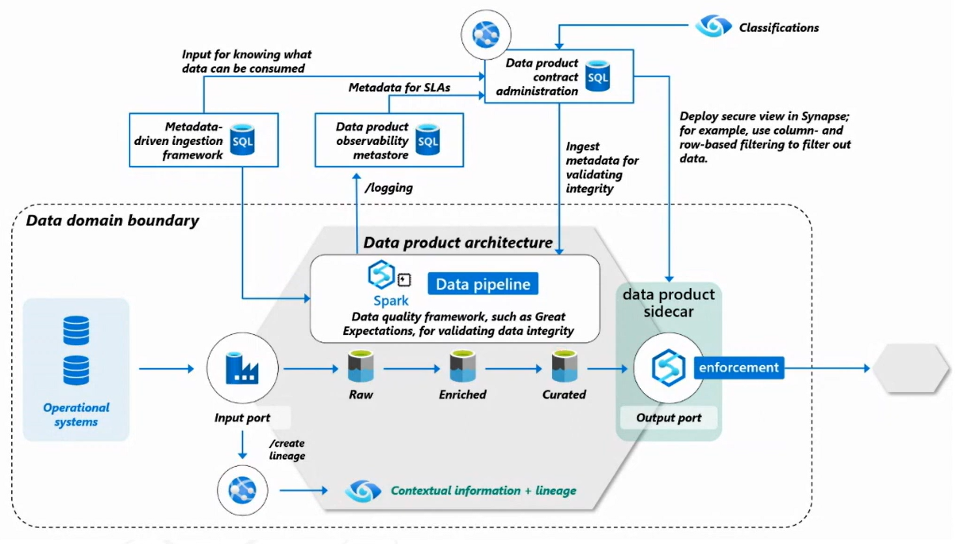
What does a data product look like ?

Slide 13
Multiple Data Products in an Enterprise
Compute
Compute
Compute
Compute
Data Collection
Data Collection
Storage
Data
Insights
Storage
Data
Insights
Data
Sources
Data
Sources
Orchestration
Orchestration
Compute
Compute
Compute
Compute
Data Collection
Data Collection
Storage
Data
Insights
Storage
Data
Insights
Data
Sources
Data
Sources
Orchestration
Orchestration

Slide 14
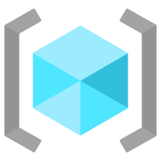

Multiple Data Products in an Azure

Slide 15
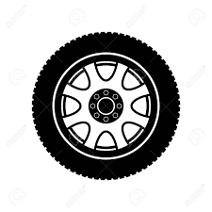
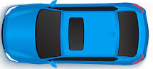
Multiple Data Products in an Azure

Slide 16

Data Mesh - Topologies
Data Mesh must be shaped by Companies unique ownership, organisational security, pace of change, technology and cost of management requirements. Not easy to balance all these requirements, so companies pick a common architecture to match most of these requirements.

Slide 17
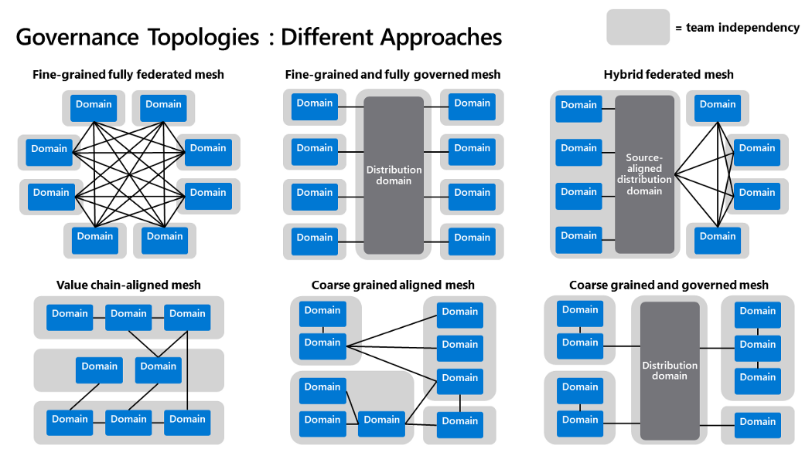
Data Mesh - Topologies
Data Mesh must be shaped by Companies unique ownership, organisational security, pace of change, technology and cost of management requirements. Not easy to balance all these requirements, so companies pick a common architecture to match most of these requirements.
Source reference: https://mrpaulandrew.com/

Slide 18
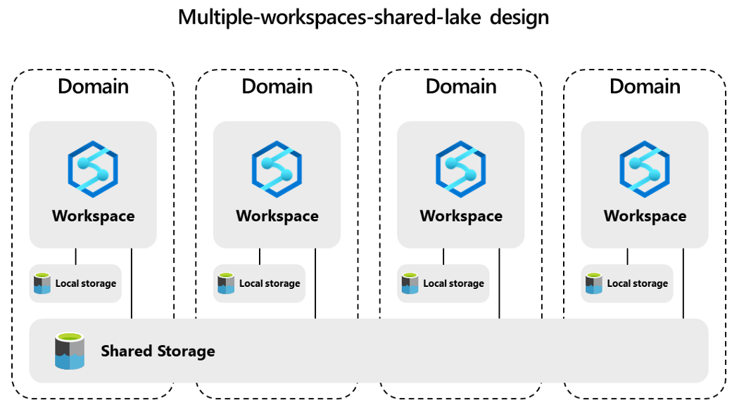
Fine Grained and Fully Governed Mesh

Slide 19
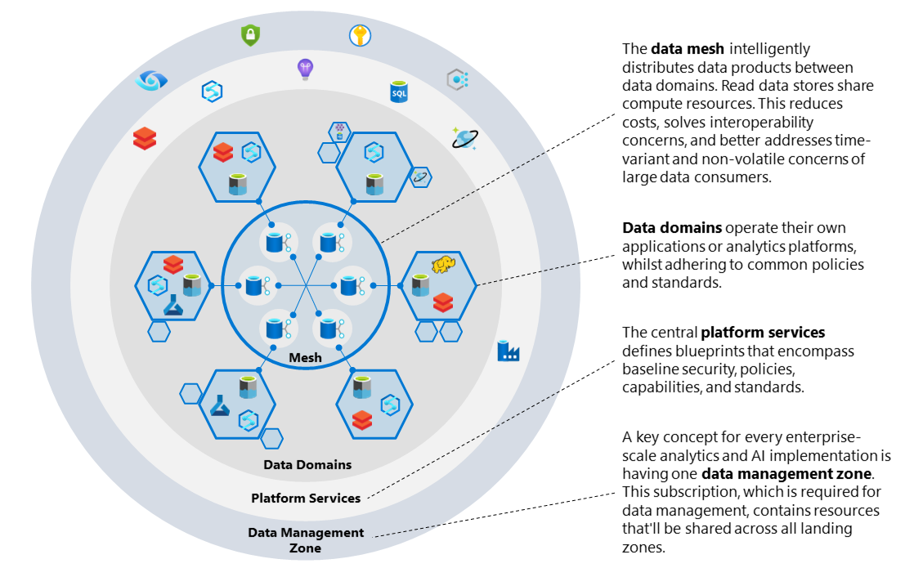
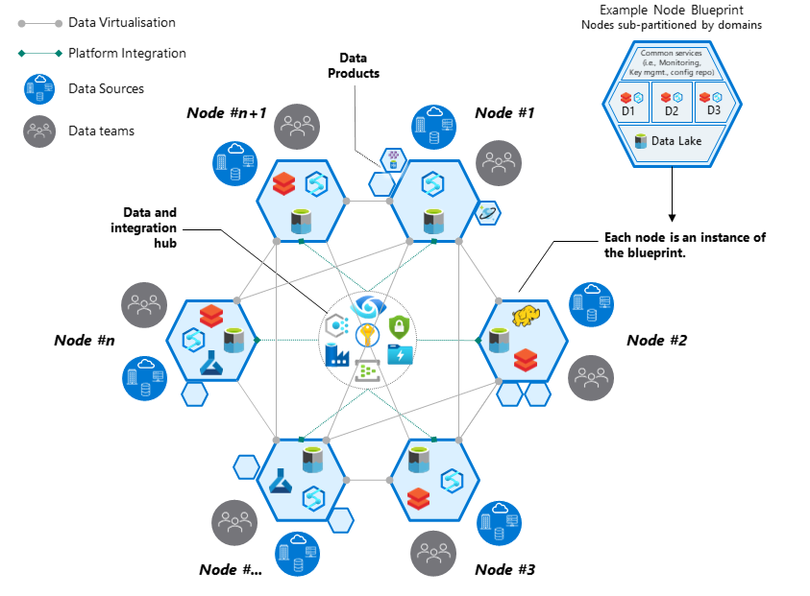
Cloud Scale analytics with Data Management and Data Landing Zone

Slide 20
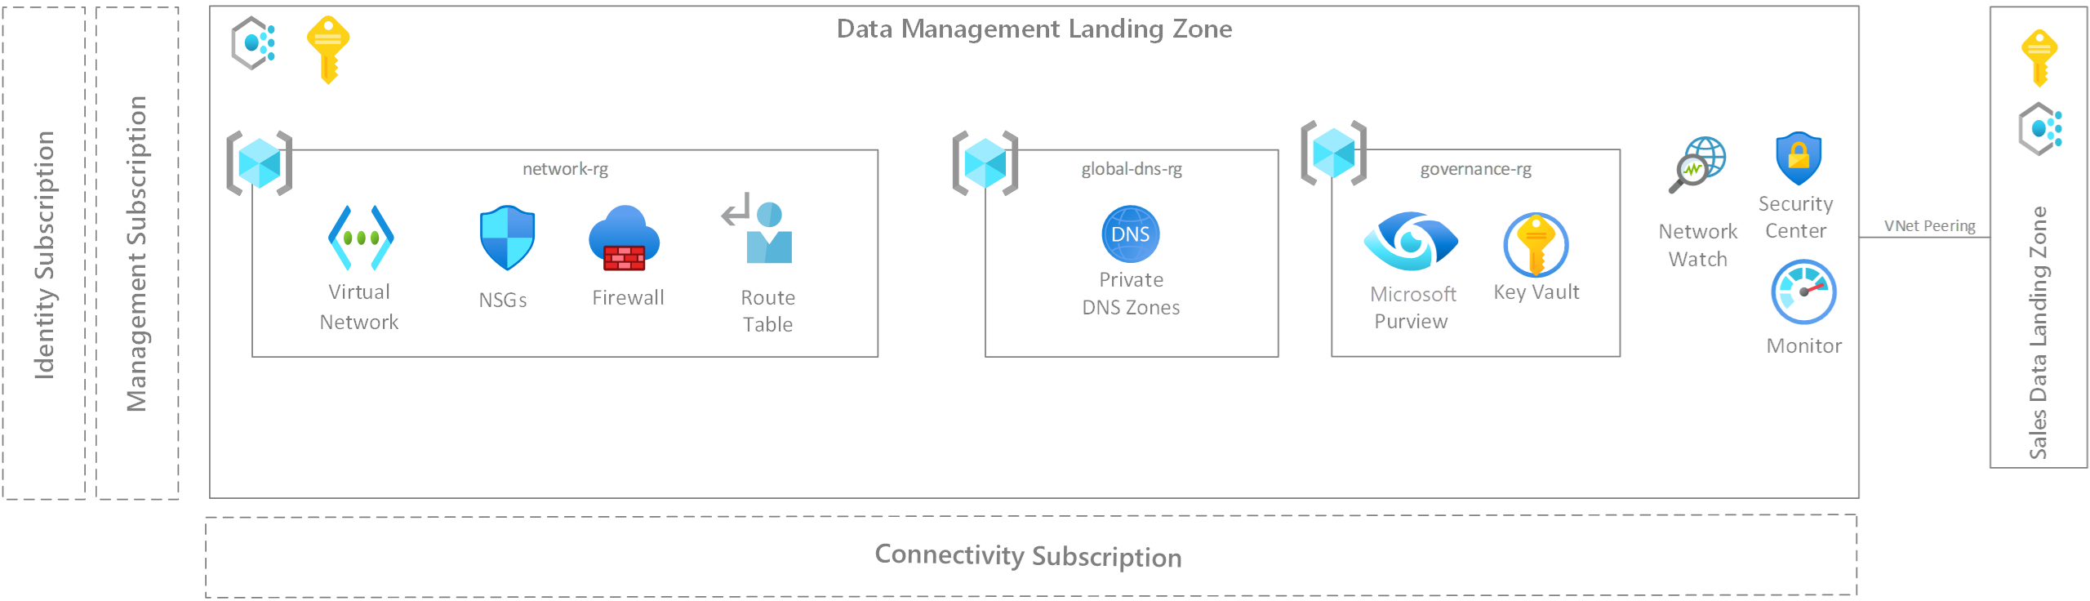
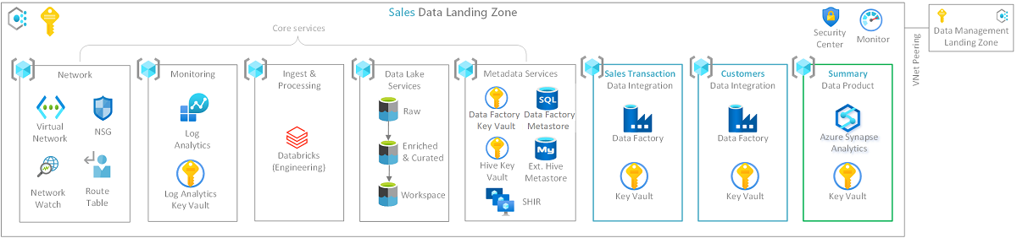
Cloud Scale analytics with Data Management and Data Landing Zone

Slide 21
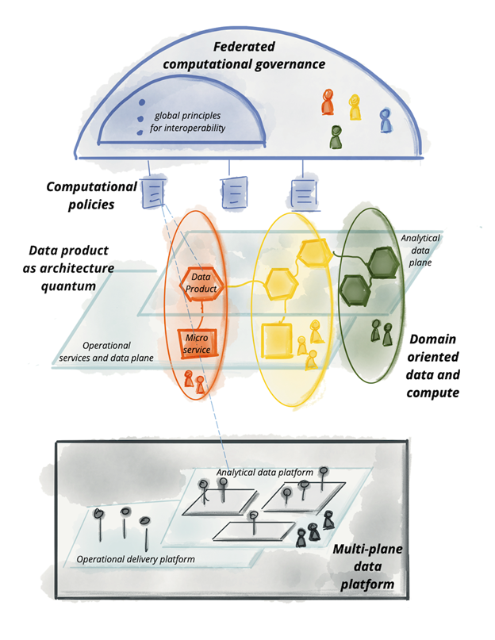
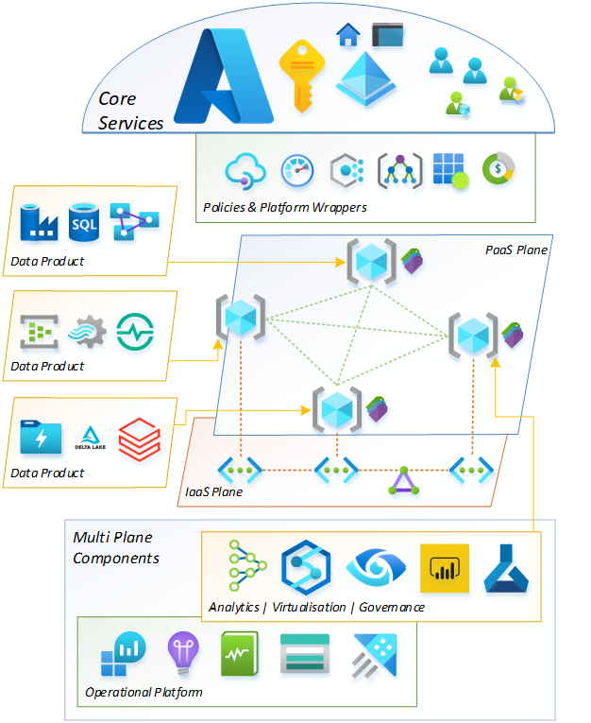
Data Mesh planes on Azure
Source reference: https://martinfowler.com/articles/data-mesh-principles.html
Source reference: https://mrpaulandrew.com/

Slide 22
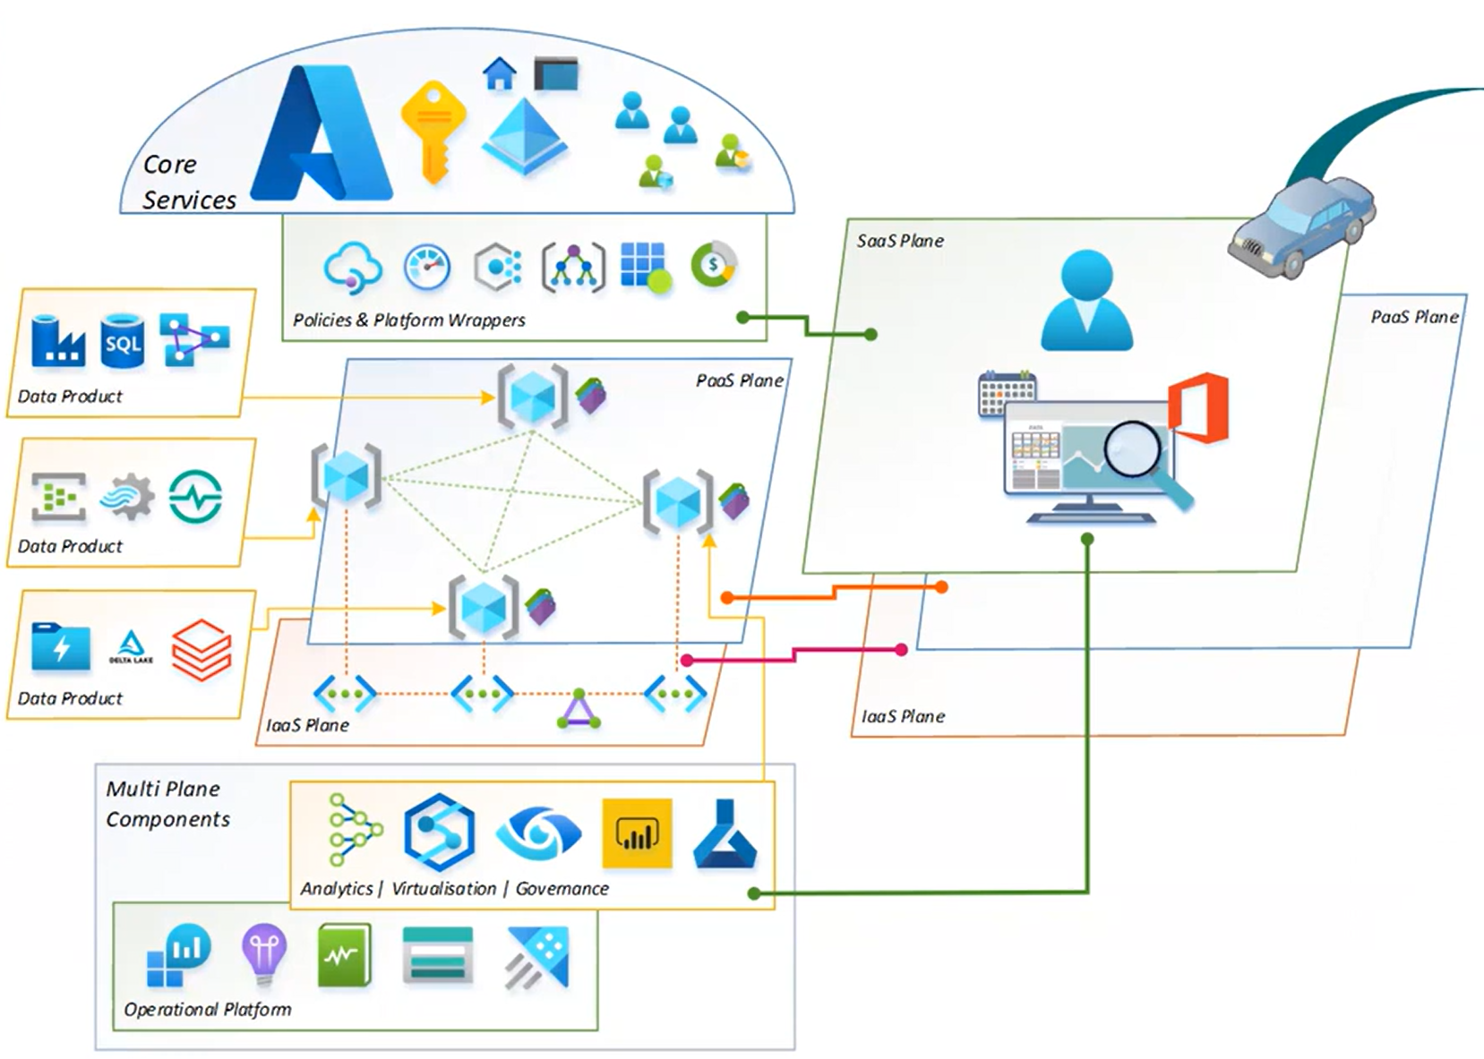
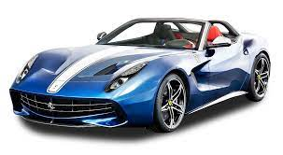


Insights across Data Mesh on Azure
Predictive and Prescriptive Analytics
What if Analysis

Slide 23


Data Mesh Anti Patterns
Zhamak Dehghani
Founded the concept of Data Mesh in 2018
Technology gaps lead to anti-patterns
What got us here, will not get us there

Slide 24
Demo

Slide 25




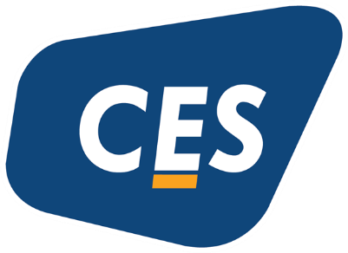

Platinum Partner
Gold Partner
Silver Partner

Slide 27
Implementing Data Mesh on Azure
Shanawaz Sheriff
https://www.linkedin.com/in/shanawaz-sheriff/
Practice Head – Data Analytics - Acuvate
Shanawaz.sheriff@acuvate.com

